Slide 1



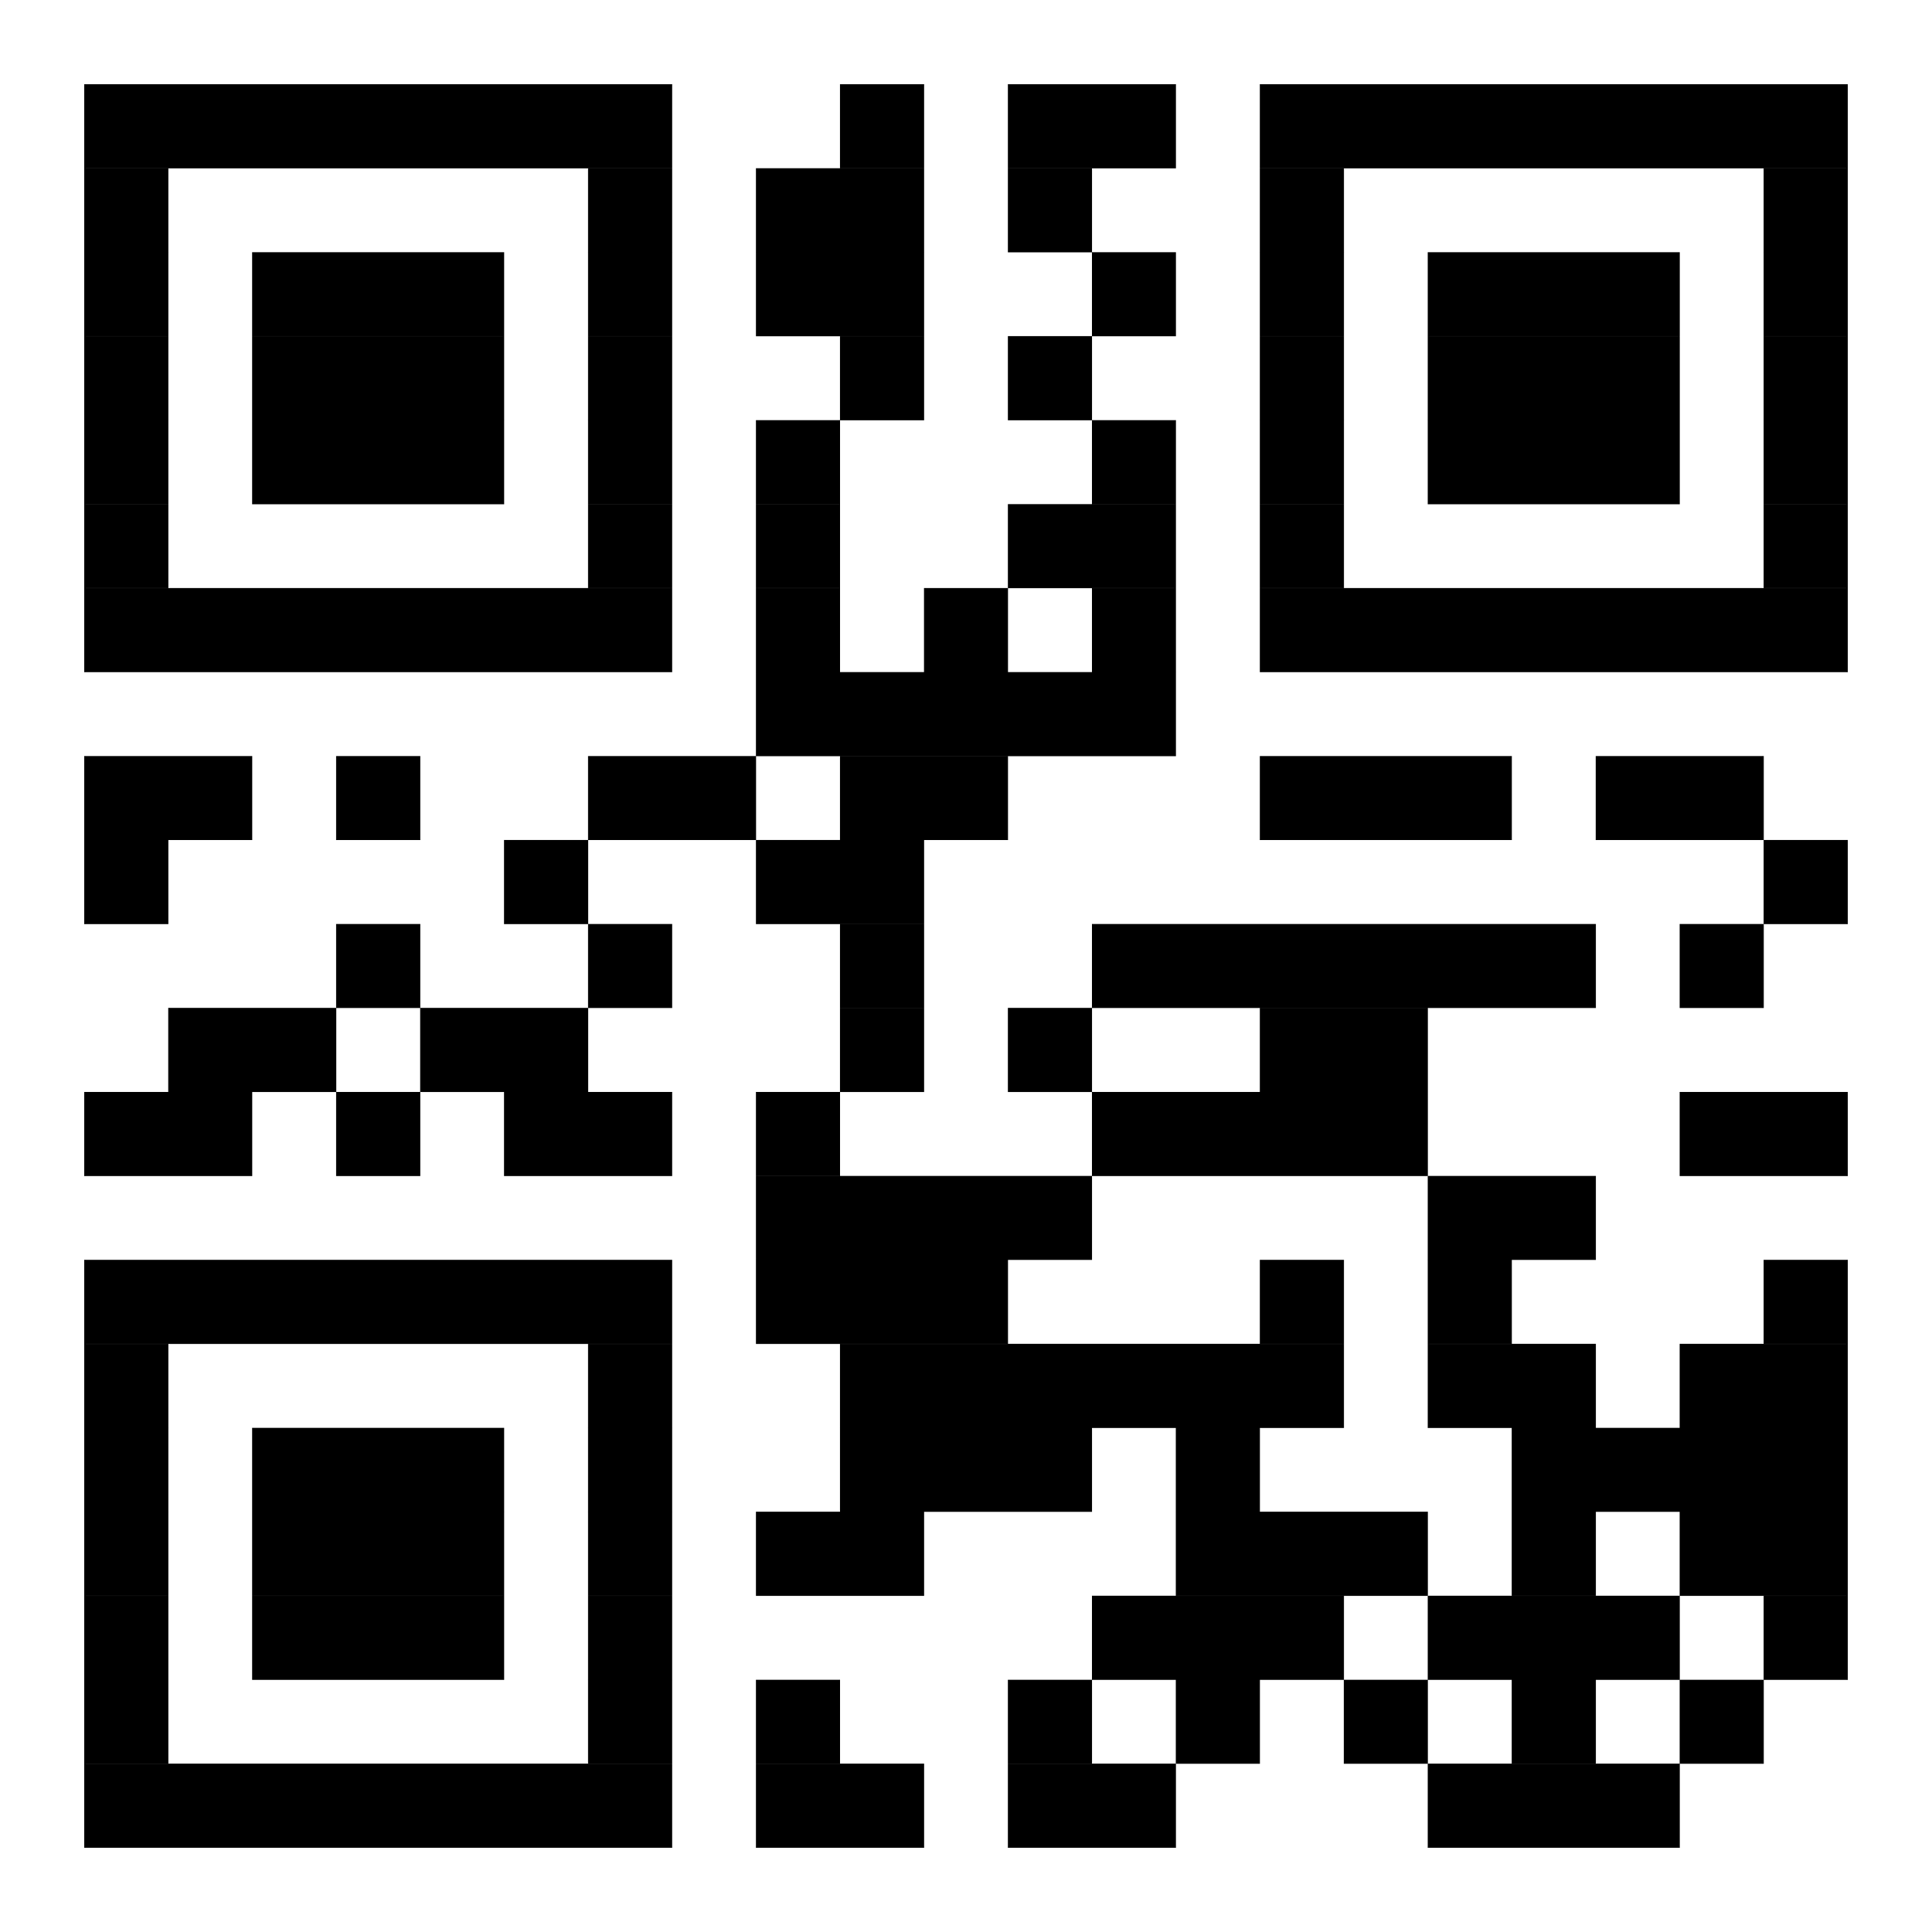


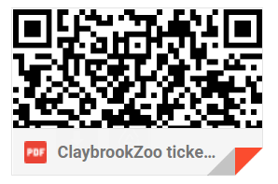
Subject: ORDER CONFIRMATION
Dear Title First_Name Surname, (e.g. Thomas Smith)
Thank you for booking the tickets to the Claybrook Zoo. We can’t wait to welcome you !!
We’ve attached your tickets to visit the Claybrook Zoo
Your tickets at a glance
✔ Manage your tickets
✔ Book additional tickets quickly
✔ Explore other features
Get our app
Opens tickets on the app (customer has to sign in first)
Have the app? View tickets
Alternatively you can show the attached etickets on your phone or print them out.
Order Number: Unique Order Number
Order Details
Order Date
Payment
Billing Address
Order Total
October 18, 2014
Visa ending with 7459
12, Sheep Street
Bristol
BS1 1WH
United Kingdom
£23.00
Summary
Ticket
Price
Quantity
Date
Subtotal
Adult ticket
£23
1
Friday, 24 October 2014
£23
Order Total:
£23.00
We look forward to welcoming you soon.
Kind regards,
Claybrook Zoo team
If you have any questions about your tickets please don’t hesitate to contact us on tickets@claybrookzoo.co.uk or Telephone Claybrook Zoo during our normal opening times 10-8pm
Terms and Conditions
Our Terms and Conditions apply to this booking.
This email has been sent to you by Claybrook Zoo.
Address
45 Zoo Lane , Eastlands, North Yorkshire, YR12 3TH, UK
www.Claybrook-Zoo.com

